Slide 1
Big Data Analysis
Spark Part 2

Slide 2
Spark Part1 - Spark RDD(Resilient Distributed Dataset) and DF(Data Frame)

Slide 3
Lecture Objective
Understand the origins of Apache Spark
Explore the Spark API and Interface
Hands-on program to dive into Spark

Slide 4
Spark Architecture
RDD: Resilient Distributed Dataset
DAG: Directed Acyclic Graph
Executor
Application
Job
Stage
Task

Slide 5
Spark Execution Flow

Slide 6
Spark Execution Flow
Application

Slide 7
Resilient Distributed Dataset
RDDs represent data or perform transformations on data
RDDs can be created from Hadoop InputFormats (such as HDFS files), “parallelize()” datasets, or by transforming other RDDs (you can stack RDDs)
Actions can be applied to RDDs; actions force calculations and return values
Lazy evaluation: Nothing computed until an action requires it
RDDs are best suited for applications that apply the same operation to all elements of a dataset
  Less suitable for applications that make asynchronous fine-grained updates to shared state

Slide 8
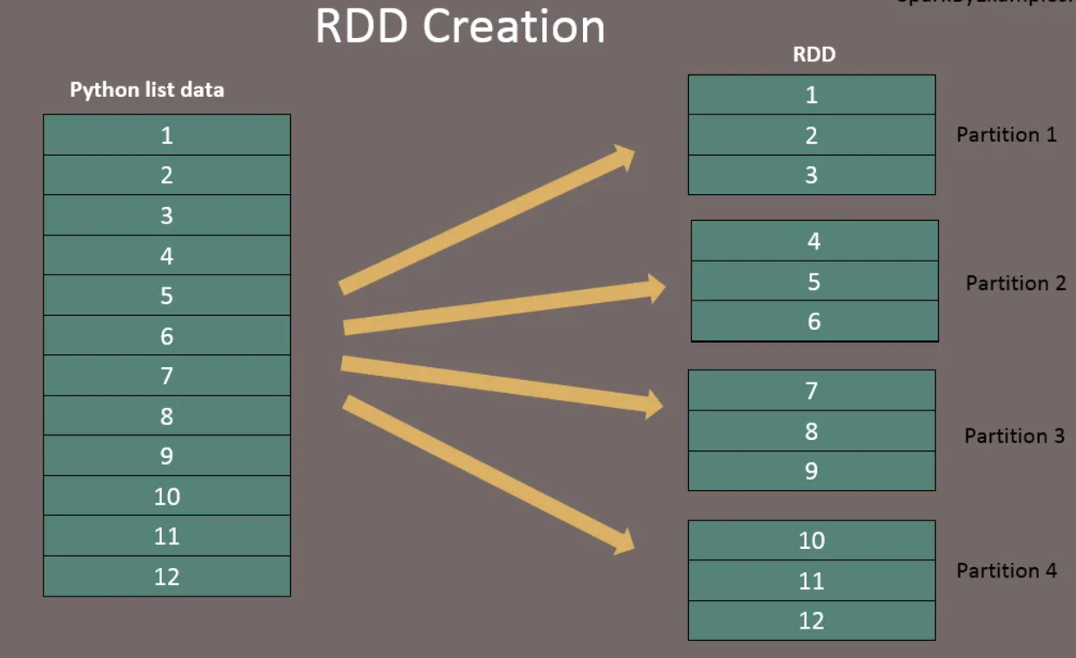
RDD

Slide 9
RDD
Transform
Create
Transform
Transform
Action
Create
Transform
Transform

Slide 10
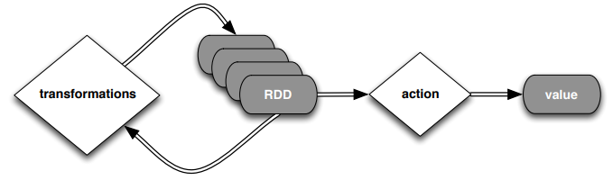
RDD
Spark can create RDDs from any file stored in HDFS or other storage systems supported by Hadoop, e.g., local file system, Amazon S3, Hypertable, HBase, RDBMS, etc.
Spark supports text files, SequenceFiles, and any other Hadoop InputFormat, and can also take a directory or a glob (e.g. /data/202111*)

Slide 11
RDD
Transformations
Transformations create a new dataset from an existing one
All transformations in Spark are lazy: they do not compute their results right away – instead they remember the transformations applied to some base dataset
  optimize the required calculations
  recover from lost data partitions

Slide 12
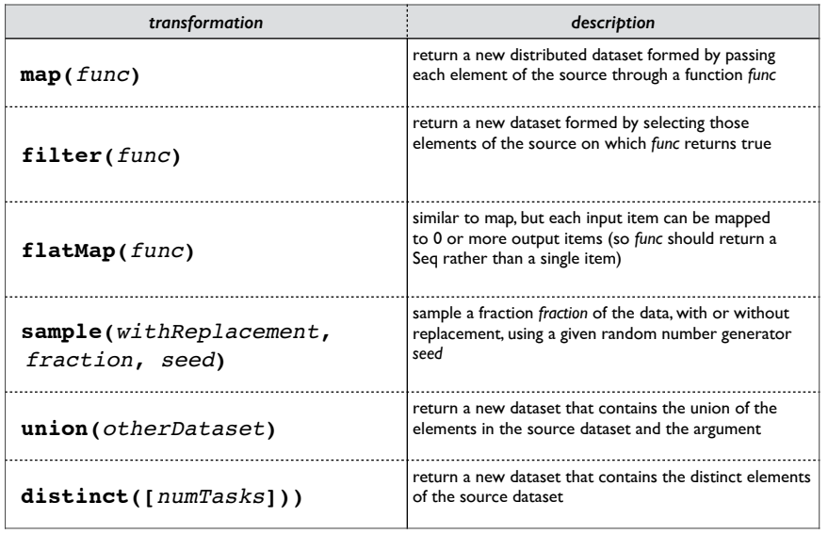
RDD
Transformations

Slide 13
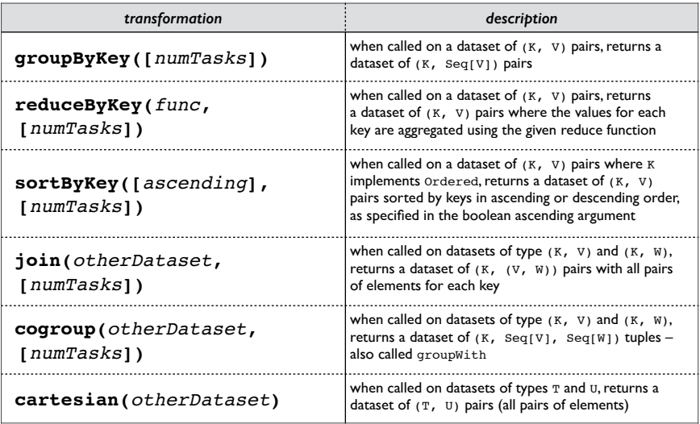
RDD
Transformations

Slide 14
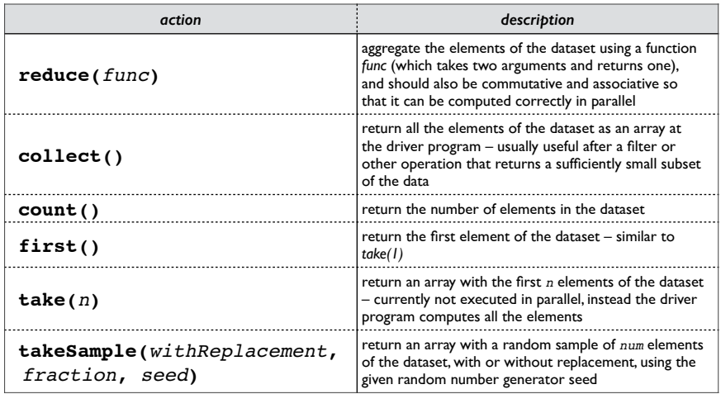
RDD
Actions

Slide 15
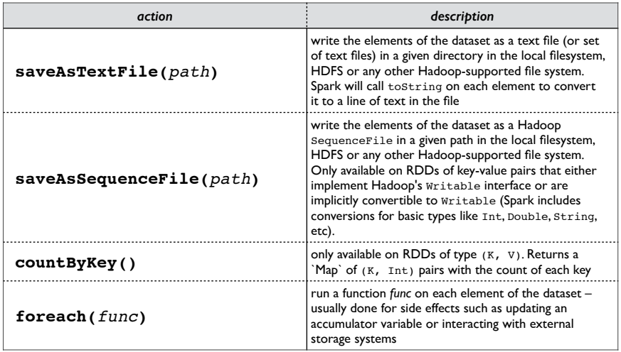
RDD
Actions

Slide 16
RDD and DataFrame
PySpark DataFrame is mostly similar to Pandas DataFrame with exception PySpark DataFrames are distributed in the cluster (meaning the data in DataFrame’s are stored in different machines in a cluster) and any operations in PySpark executes in parallel on all machines.
Pandas Dataframe stores and operates on a single machine.

Slide 17
LabS02_1 – RDD operation
Refer to the code:
  LabS02_1_RDD_Operations
Notice!
  The default Jupyter notebook is local mode, meaning all RDDs are stored on your local computer (memory).
  You can submit the RDD to the Spark Cluster

Slide 18
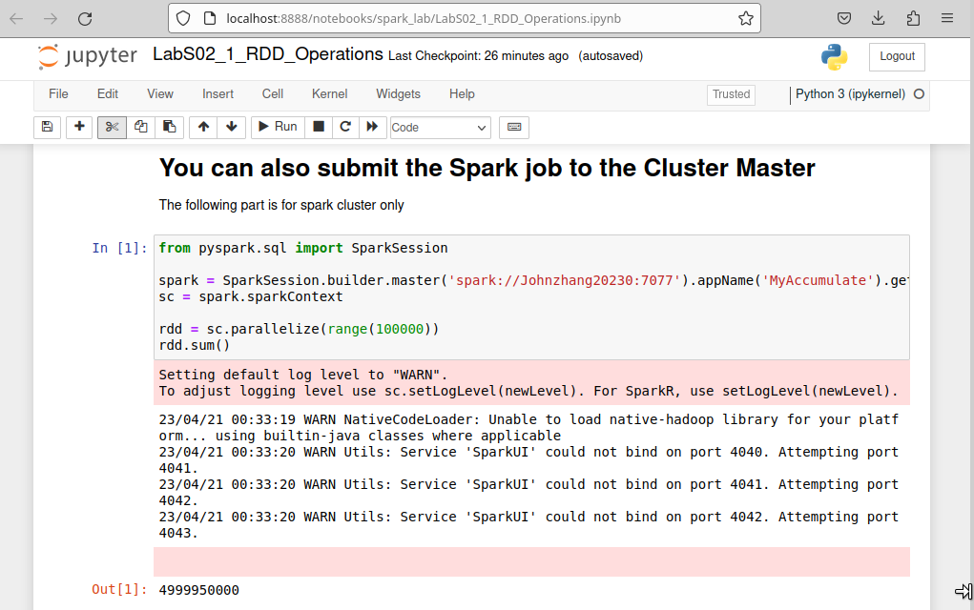
LabS02_1 – RDD operation

Slide 19
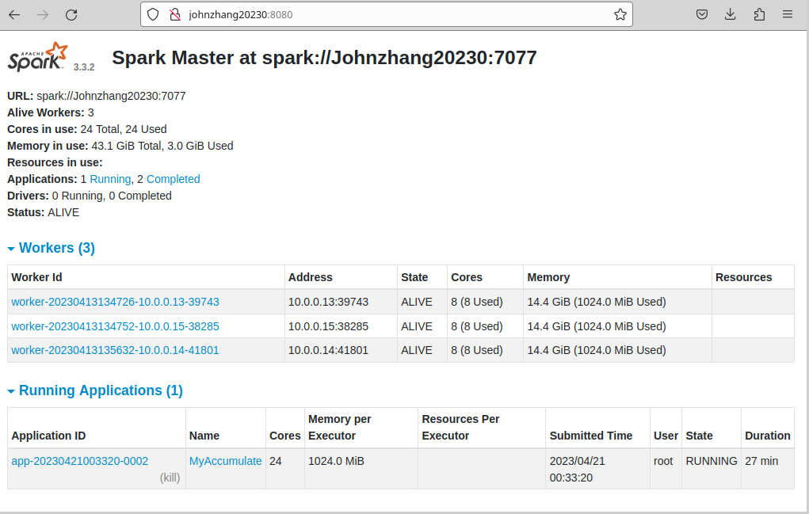
LabS02_1 – RDD operation

Slide 20
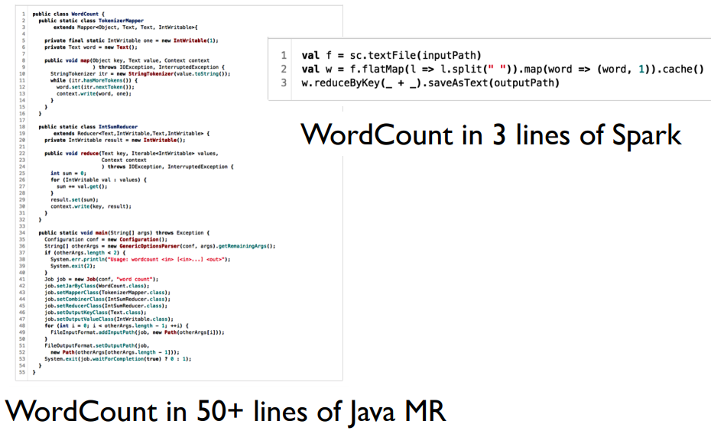
RDD WordCount
RDD can also accept textfile as input!
Means WordCount in Spark is super easy!

Slide 21
LabS02_2 - WordCount
text_file = sc.textFile(“1.txt”)
counts = text_file.flatMap(lambda line: line.split(" ")).map(lambda word: (word, 1)).reduceByKey(lambda a, b: a + b)
#Option 1: print output
output = counts.collect()
for (word, count) in output:
print("%s: %i" % (word, count))
#Option 2: save as text file
#counts.saveAsTextFile(“outputpath")
Refer to the code
  LabS02_2_WordCount

Slide 22
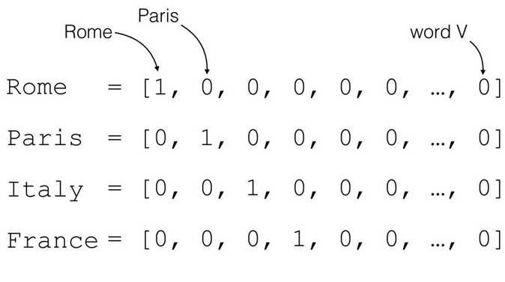
Count Vectorization
Processing words is not good in language processing, we vectorize the words:

Slide 23
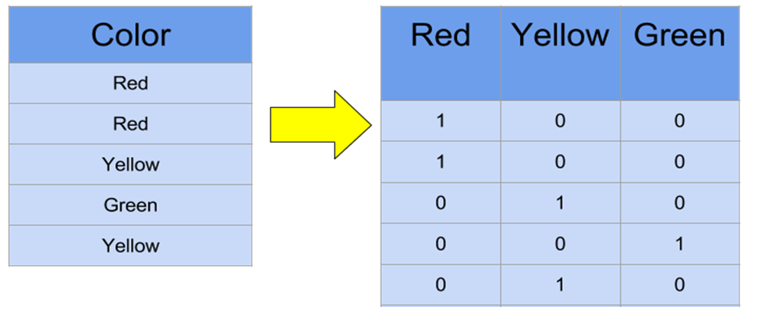
Count Vectorization
The we can count the vectors (i.e., bag of word vectors):

Slide 24
LabS02_3 – Count Vectorization
Refer to the code
  LabS02_3_CountVectorization

